Slide 1

Forest Cover Type Prediction
Group 6:
Ahmed Mahmoud
300389380
Moataz Habib
300389907
Yousef Mohamed
300389908

Slide 2

Problem's Overview

Slide 3
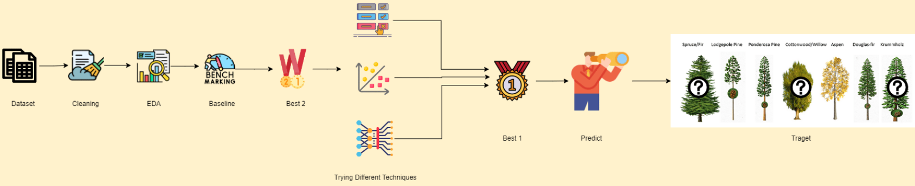
The Problem

Slide 4

Dataset's Overview (EDA)

Slide 5
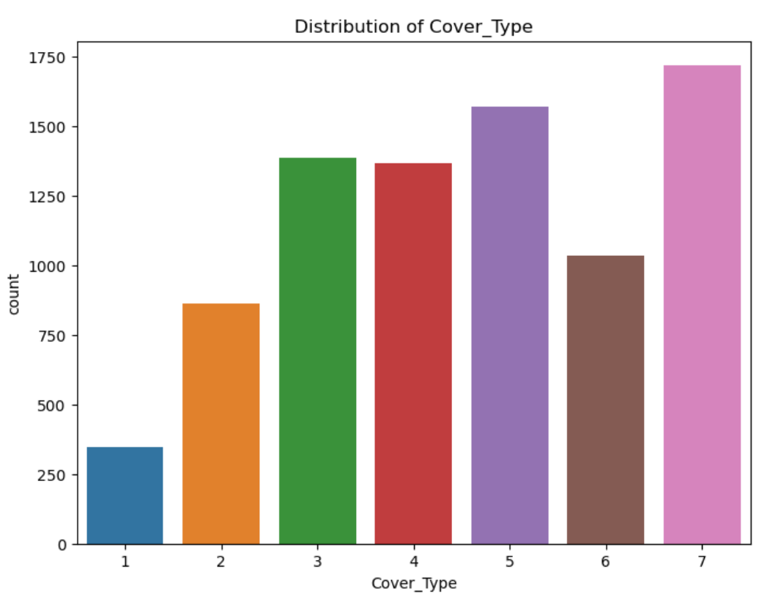
Distribution of Cover type

Slide 6
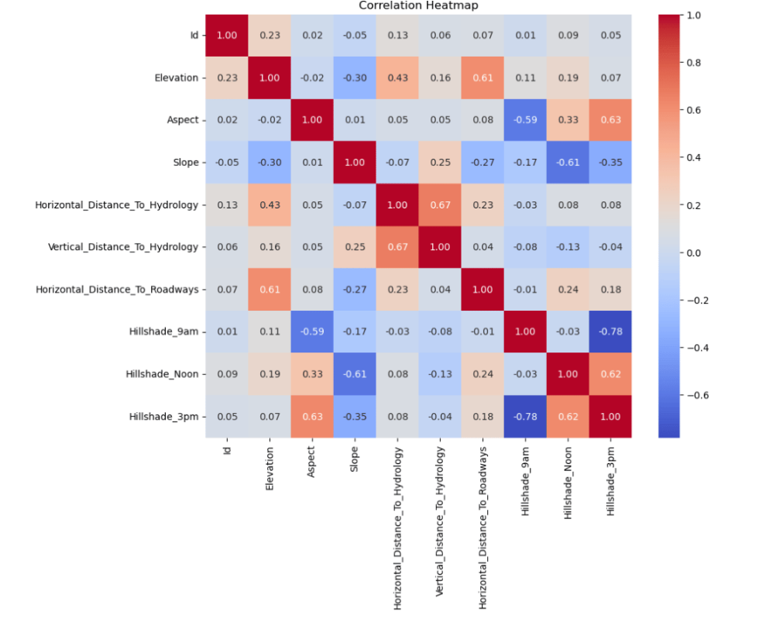
Correlaction

Slide 7
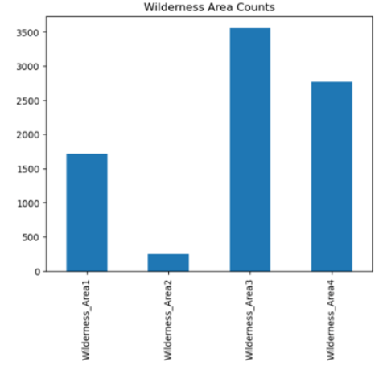
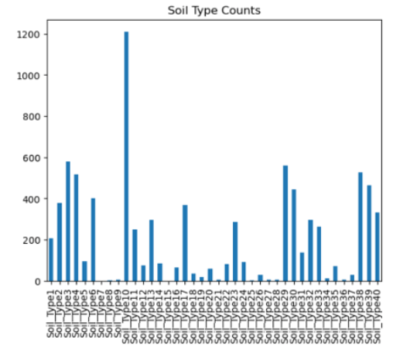
Categorical Feature Analysis

Slide 8
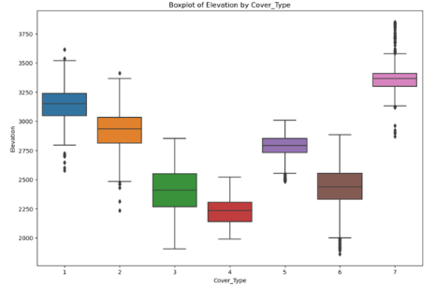
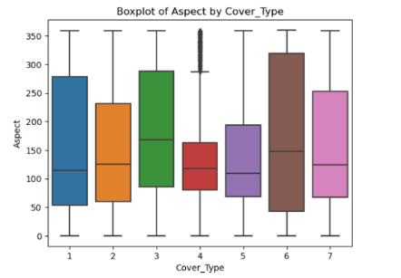
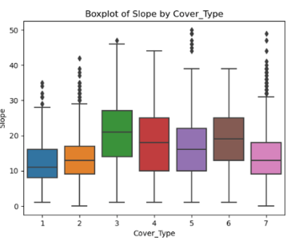
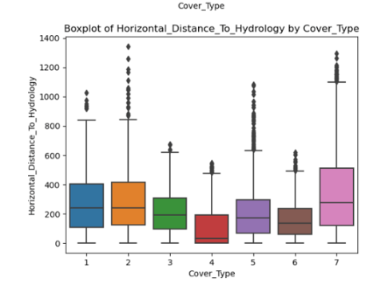
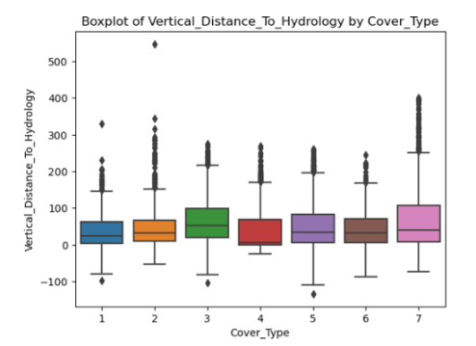
Numerical Feature Analysis

Slide 9
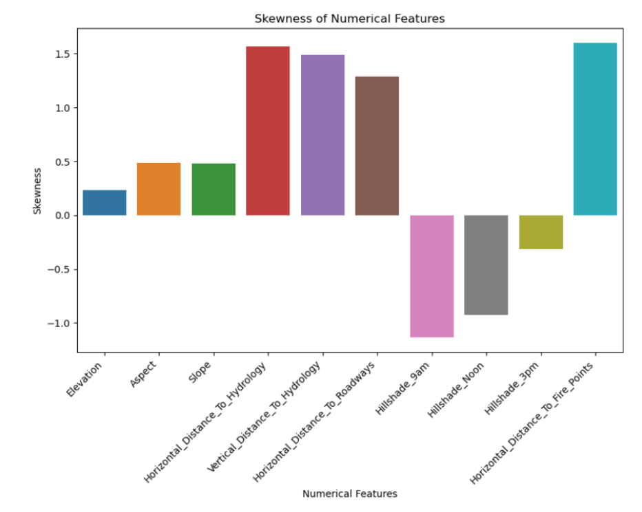
Skewness Analysis

Slide 10
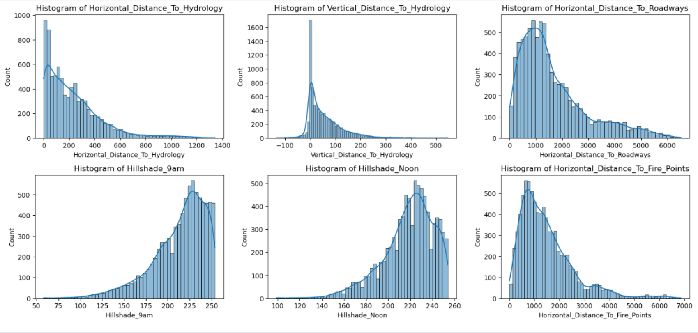
Skewness Analysis

Slide 11

Process of the Project

Slide 12
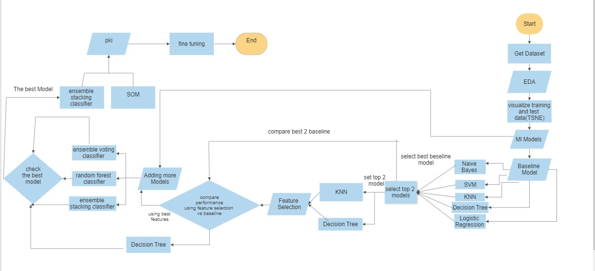
The process

Slide 13
Problem Nature

Slide 14
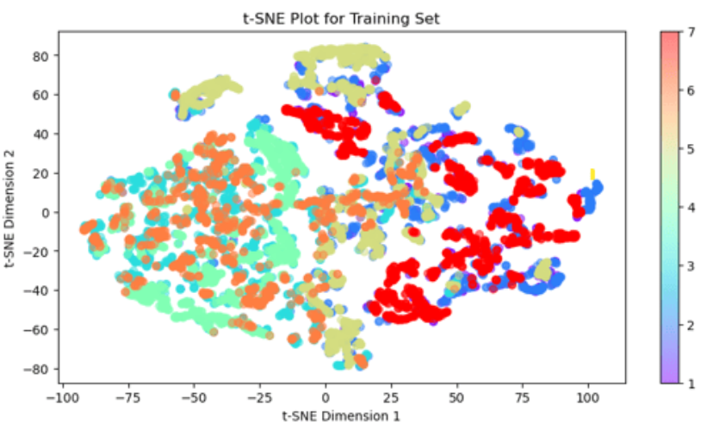
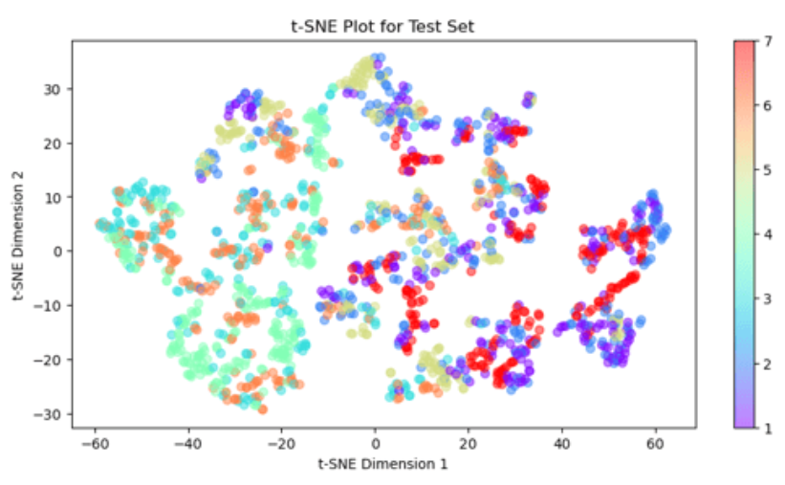
T-SNE For The Data
t-SNE for Training
t-SNE for Test

Slide 15
Baseline Performance

Slide 16
Results
Model
Accuarcy
KNN
0.738361
Logistic Regression
0.474098
SVM
0.561311
Decision Tree
0.758033
Naive Bayes
0.601311

Slide 17
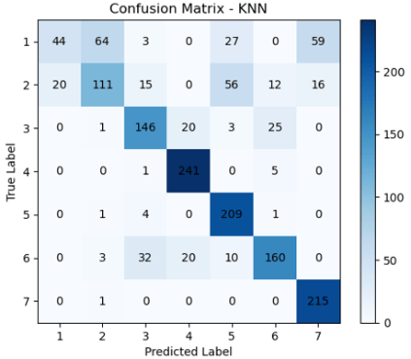
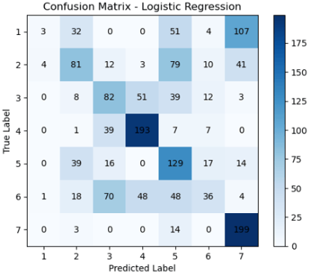
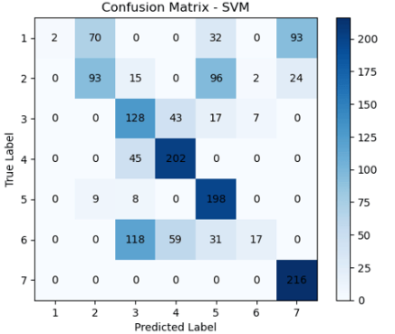
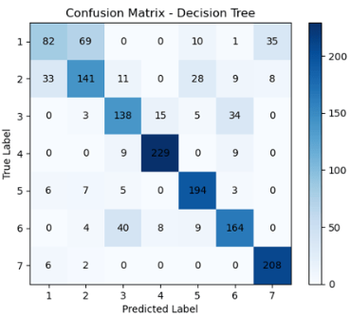
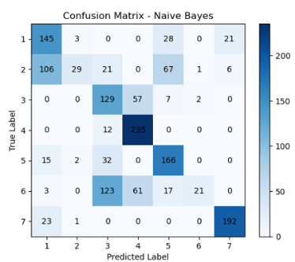
Confusion Matrix

Slide 18
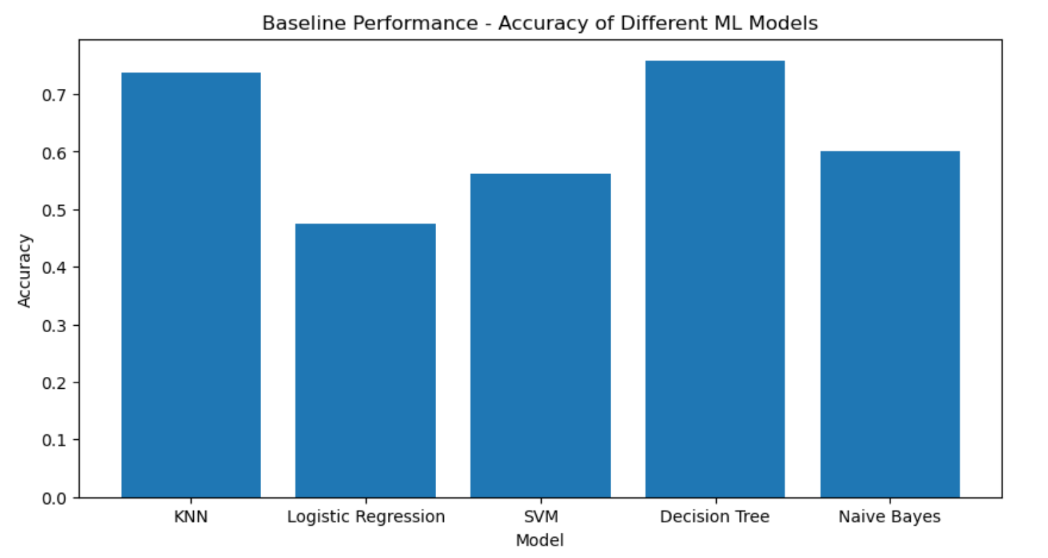
Bar-chart of the Accuracy

Slide 19
First Improvement Strategy: Comparing Dimensionality Reduction to Feature Selection

Slide 20
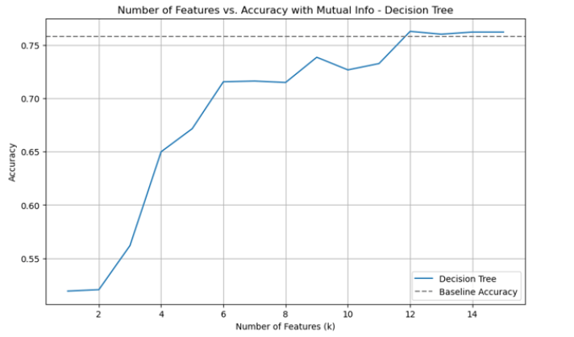
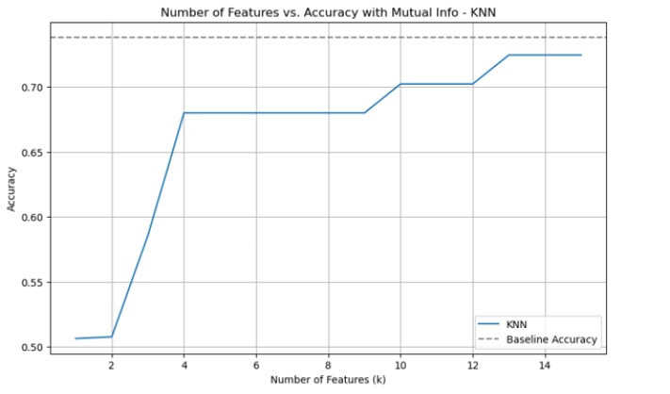
Filter Method

Slide 21
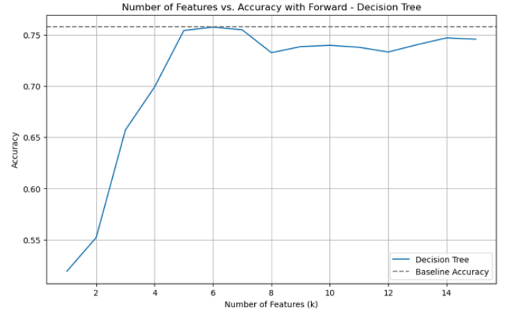
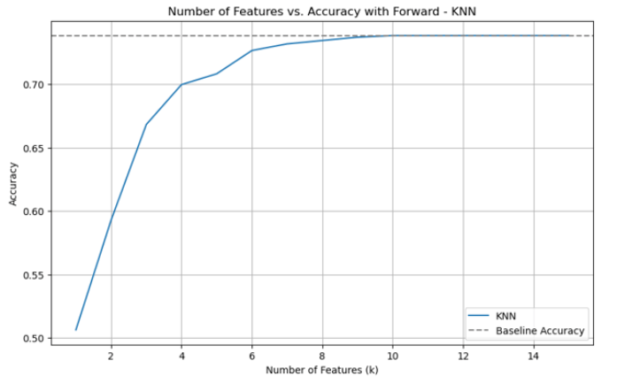
Wrapper Method

Slide 22
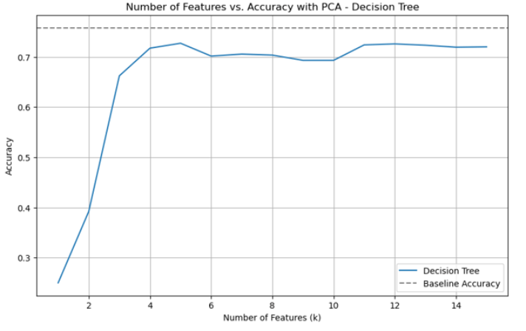
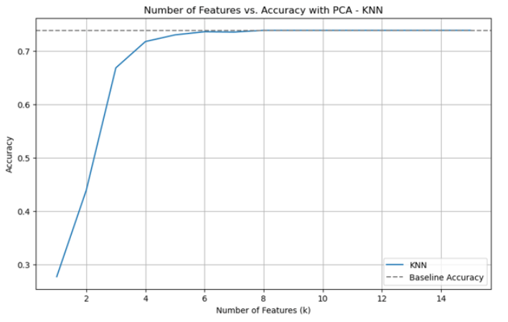
PCA

Slide 23
Adding More Models

Slide 24
Results
Model
Accuracy
Random Forest
0.8125
Stacking Ensemble
0.8328
Voting Ensemble
0.8020
Decision Tree with Feature Selection
0.7626

Slide 25
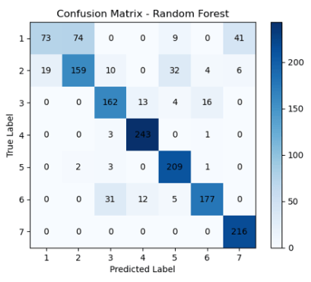
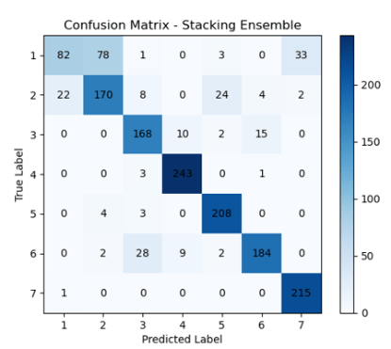
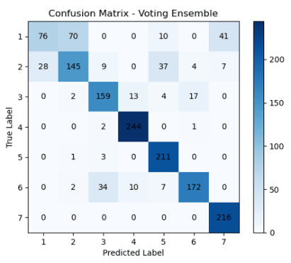
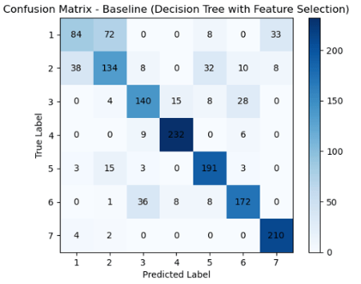
Confusion Matrix

Slide 26
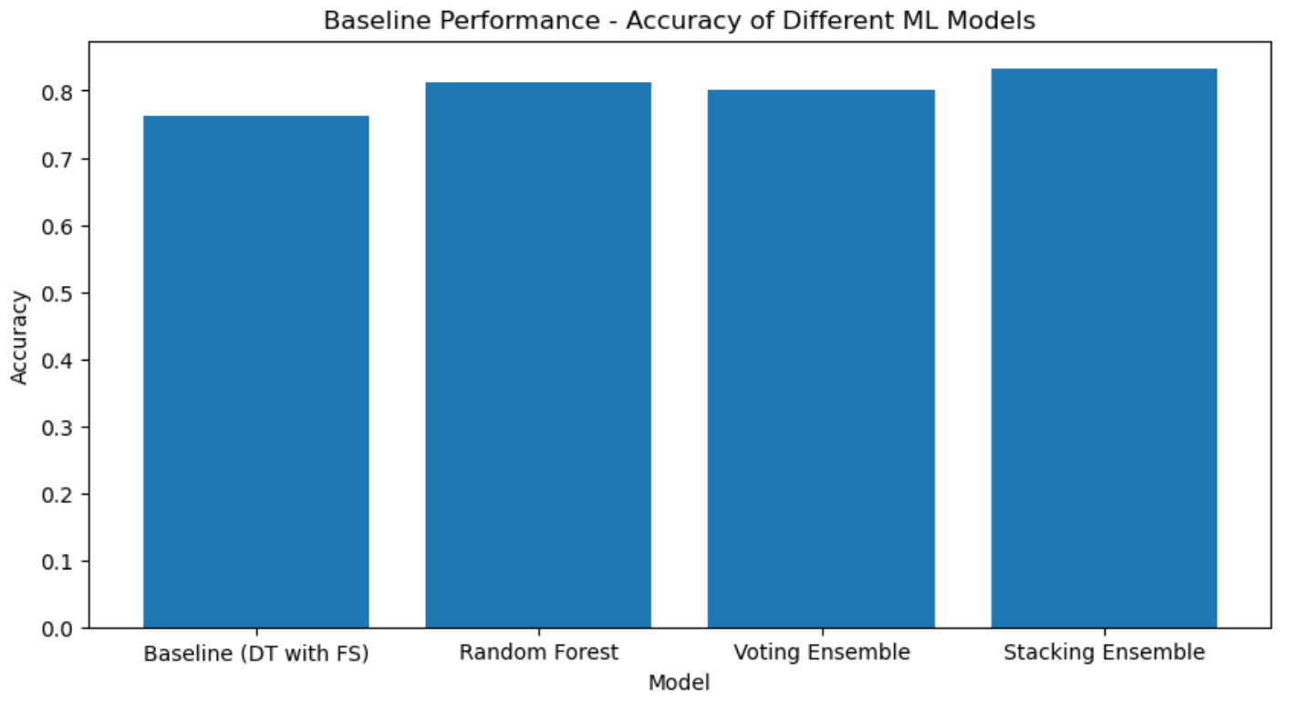
Bar-chart Of The Accuracy

Slide 27
Supervised & Unsupervised Combination via PKI

Slide 28
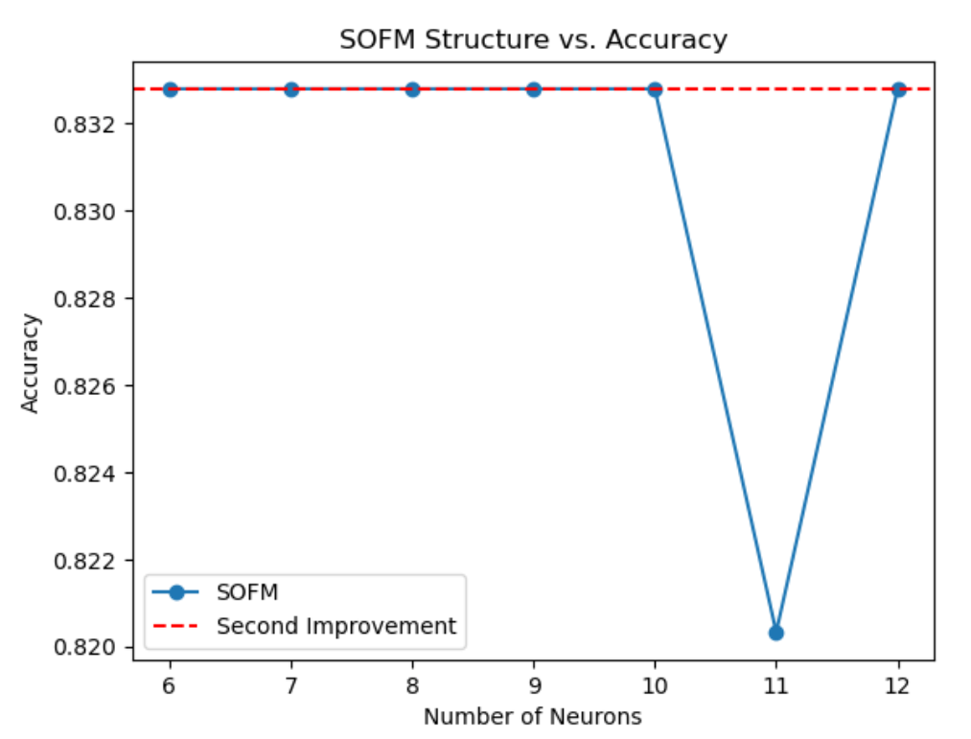
Results

Slide 29
Applying Parameter Fine Tuning

Slide 30
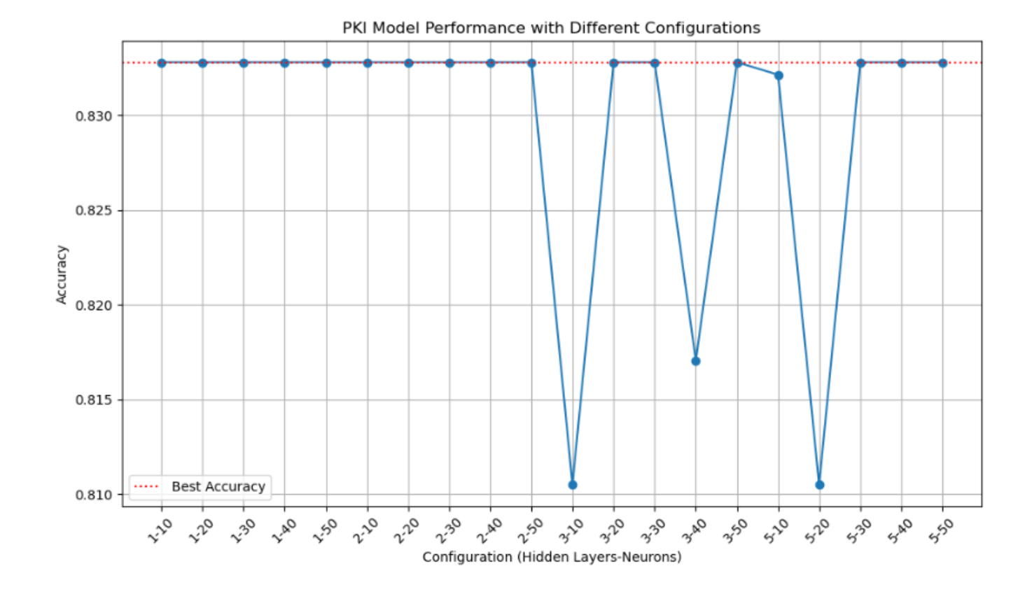
Results

Slide 31
Conclusion
Based on the analysis and experiments performed:
The best-performing models were KNN and Decision Tree (DT) without any feature selection. Using the Filter Method (mutual_info_classif) for feature selection, Decision Tree with the selected features achieved the best performance.
After adding more models, Stacking Ensemble with the selected features from the second improvement became the best-performing approach.
The PKI strategy did not significantly improve the accuracy of the models compared to the previous improvements.
Fine-tuning the models did not result in a substantial increase in accuracy compared to the previous improvements.
Overall, combining feature selection (Filter Method) and Stacking Ensemble has provided the best results. Fine-tuning the models and using PKI did not lead to significant improvements, suggesting that the initial feature selection and ensemble approaches were effective for this task.

Slide 32

Thank you!

